Slide 1
A slide series to help the curious become familiar with RBTI
This series is designed to help newcomers to the Reams Biological Theory of Ionization (RBTI) grasp fundamentals. It is presented as a series of “rules” (almost everything Reams taught is important enough to easily be thought of as a rule). These “rules” can be distinguished from certain major rules that Reams wanted all his students to memorize.
This series is not copyrighted and you are free to use it to further the RBTI message in any way you choose. However, you may wish to contact brixmanus@gmail.com to obtain the most recent file before making a public presentation if the date seems excessively old. Date last modified: 4/25/2021

Slide 2
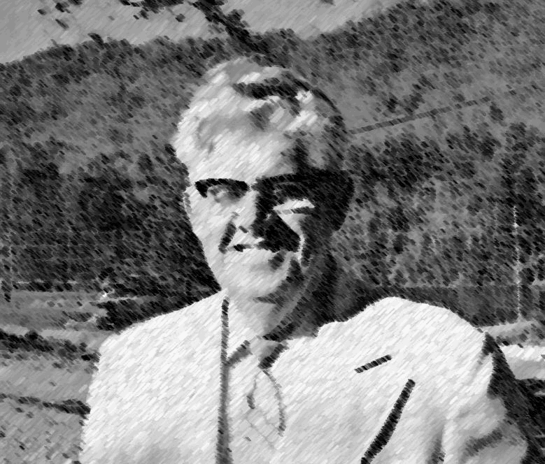
The Story of RBTI
In 1968, an Orlando biophysicist retired from his medical laboratory and agricultural duties. For four decades he had been quietly restoring the health each year of a handful of people who had been dismissed by the medical community.
Focusing entirely on diet, and driven by Jesus’ mandate to “Heal the sick,” Carey Reams led thousands of people to an understanding of true health over the next 17 years.

Slide 3
Abandoning blood testing in favor of much more accurate urine & saliva analysis, Reams was able to demonstrate that almost all drugs, surgery, and radiation could be done away with.
Reams proved over and over that when a person’s urine & saliva is kept in narrow bounds, new disease simply has no place to set up shop, and old disease is shown the door.
And those “narrow bounds”? Simply this…

Slide 4
Urine brix (carbohydrate) should be 1.5…
Urine pH should be 6.4…
Saliva pH should be 6.4…
Urine conductivity should be 6-7 conductance units….
Urine clarity should be limited to 40,000 dead cell fragments per liter…
Urine nitrate should be 3 parts per million, and…
Urine ammonia should be 3 parts per million.

Slide 5
While many clients are content to simply let an RBTI consultant guide them toward the desired analysis, many want to know the what, where, when, who, and how of the Reams Biological Theory of Ionization process.
The following PowerPoint slides are designed to help answer as many questions as possible about the theory and its author, Dr. Carey A. Reams.
Drawn from transcripts of one of the many hundreds of formal classes that Reams offered, they touch into a most fascinating story.

Slide 6
RBTI is not medicine (slide 1)
The teachings of
Dr. Carey A. Reams
There is no logical way to reason, in any shape, form, or fashion, that the Reams Biological Theory of Ionization is the practice of medicine or one of the healing arts. It deals only with food and diet. Everyone is on a diet of some kind even of his own choosing.
The practice of medicine deals with drugs and surgery. Many doctors discredit the idea that food has anything to do with illness. The last I knew, only two of the medical colleges in the United States offer instruction on diet, and these two colleges only give two college hours about diet.

Slide 7
RBTI is not medicine (slide 2)
The teachings of
Dr. Carey A. Reams
There are no common grounds for comparison between the Reams Biological Theory of Ionization and the practice of medicine, because of the following:
The Reams Biological Theory of Ionization is the practice of health through diet.
The RBTI deals with the mathematics and chemistry of a gain or loss of ENERGY, which is determined by accurate laboratory analysis on urine and saliva.
The RBTI deals with CAUSE and EFFECT due to a mineral deficiency.
The RBTI deals with a specific diet for only one individual and the foods that will bring about an increase of RESERVE ENERGY.
The RBTI never deals with drugs; however, when anyone is ill they should be entitled to the FREEDOM OF CHOICE to choose the RBTI program, or any one or all of the HEALING ARTS to aid them in regaining their health.

Slide 8
RBTI is not medicine (slide 3)
The teachings of
Dr. Carey A. Reams
The RBTI deals with cleansing the temple by drinking clean, cool, pure distilled water, according to or in ratio to weight. The drinking of water has more to do with recovery than the drugs. The RBTI deals with the whole man, the whole woman, the whole boy or girl; such as a tailor-made diet, distilled water, fresh air and supervised exercise according to the reserve energy rating. All this is done on an individual basis predetermined by the body chemistry.
The RBTI maintains that all maladies begin with the organs governed by the vagus nervous system. The cause of the malfunctioning of the vital organs is that there is not enough mineral in the diet to replace the worn-out cells, causing a malfunctioning or decrease in the production of enzymes to supply other organs with the necessary total daily nutrient to maintain maximum amount of reserve energy.

Slide 9
RBTI is not medicine (slide 4)
The teachings of
Dr. Carey A. Reams
The RBTI maintains that bacteria and fungus are not the cause of disease, however, they will move in when free room and board is furnished. They do aggravate the condition and cause fevers because the body is so deficient in mineral that it (the body) cannot resist their attacks.
The RBTI maintains that diseases always strike in the weakest area.
The RBTI does accept the use of vaccines only as a means of last resort.
The RBTI deals with health and happiness and a long, useful life, all well-planned and guided by the RBTI analysis.
The RBTI is merely adherence to Biblical laws for perfect health.
The RBTI gives God the glory for the restoration of health.
[Above extracted from pages 53, 54, 55 "Choose Life or Death"]

Slide 10
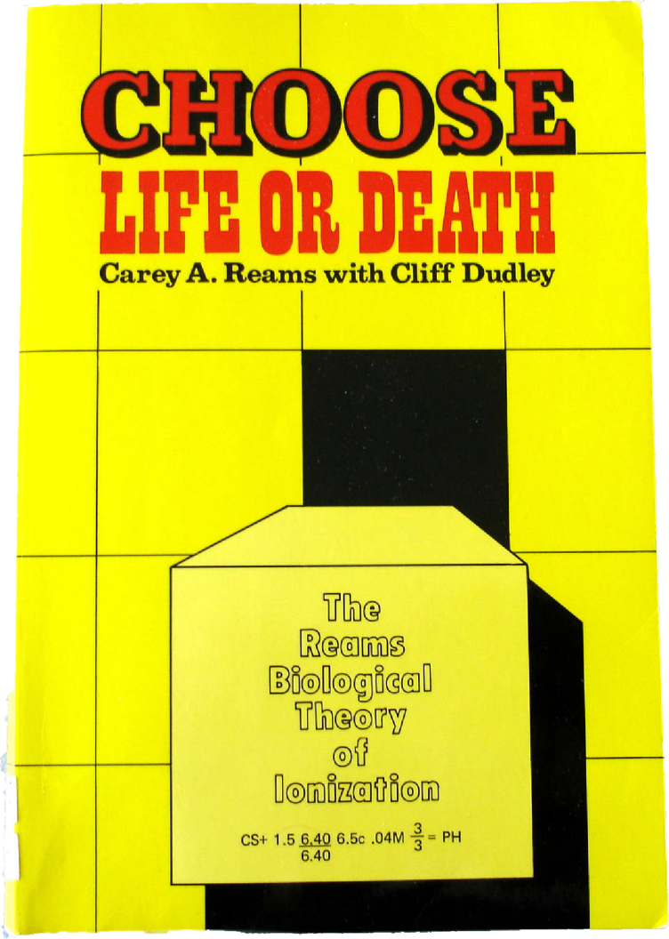
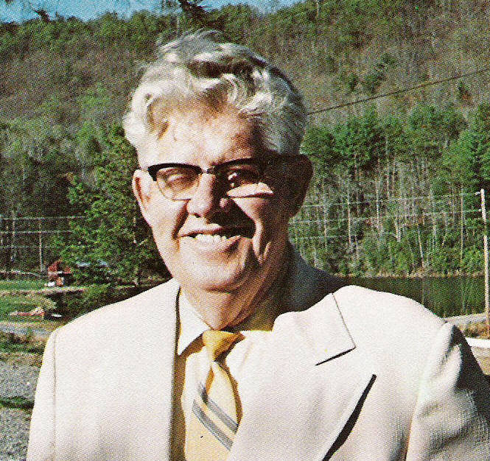
In Reams’ own words…
The teachings of
Dr. Carey A. Reams
This short book (170 pages)
was written to explain the
fundamentals of the RBTI

Slide 11
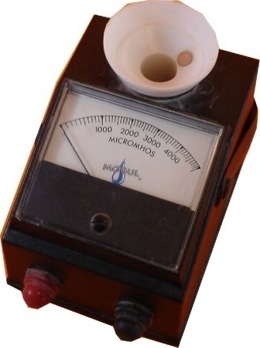
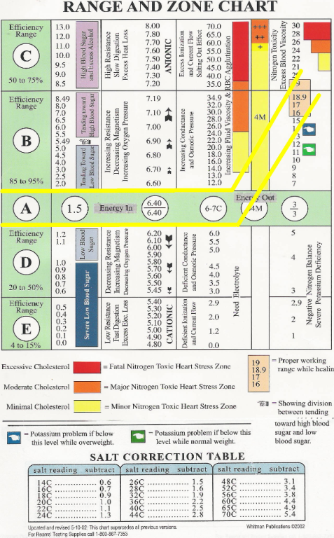
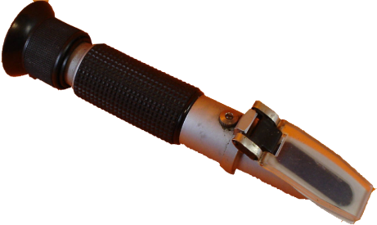
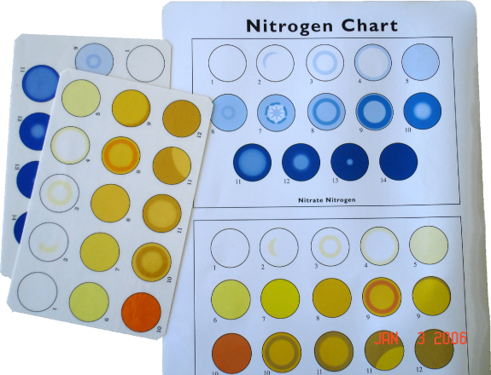
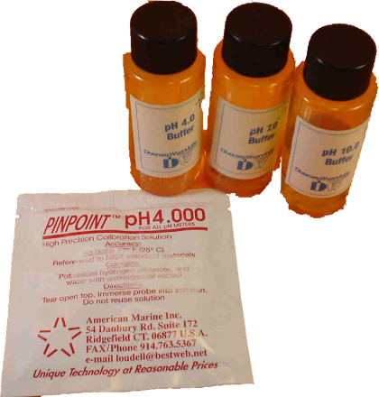
Much like your water treatment plant, the RBTI uses instruments to analyze the water of your life…
The teachings of
Dr. Carey A. Reams

Slide 12

Let’s go on a journey…
The teachings of
Dr. Carey A. Reams

Slide 13
And see things from another angle…
The teachings of
Dr. Carey A. Reams

Slide 14
Rule 1: God never repairs a damaged cell…
The teachings of
Dr. Carey A. Reams
God never repairs a damaged cell. Never! He throws it out, and puts
a brand-new one in its place. God is not in the second-hand parts
business.

Slide 15
Rule 2: RBTI is what the Bible message is about...
RBTI (the Reams Biological Theory of Ionization) is what the Bible message is about. It is, simply, heal the sick, heal the sick.
The teachings of
Dr. Carey A. Reams

Slide 16
Rule 3: In a great variety of food there is safety…
Variety is the spice of life. And in a great variety of food there is safety.
The teachings of
Dr. Carey A. Reams

Slide 17
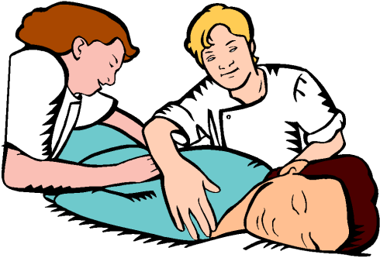
Rule 4: Healing comes when you learn what diet fits each individual…
The teachings of
Dr. Carey A. Reams
Healing power is in your hands when you learn what diet fits each individual.
Let’s not be forgetting that all healing comes from God
I’m really good!

Slide 18

Rule 5: The Bible is the best health book that was ever written…
Open your minds and hearts to the beautiful message that's in the Bible, the health book. If anybody asks you to recommend a health
book, you recommend the Bible, the best health book that was ever written; and it's infallible, it works every time.
Does Reams mean most of the time?
He means all the time
The teachings of
Dr. Carey A. Reams

Slide 19


Rule 6: It is God who does the healing…
The teachings of
Dr. Carey A. Reams
So then I healed everything wrong with him.
I don’t think he has a clue
It is God who does the healing, not you, not I.

Slide 20
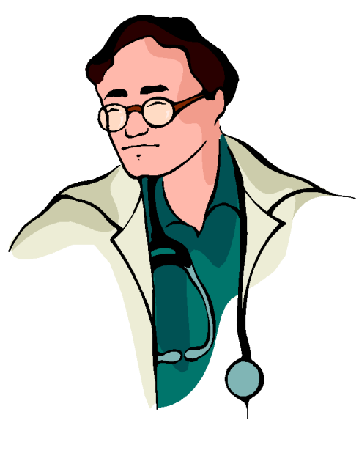
Rule 7: Most difficult part is to unlearn some things…
I'll tell you this, friends, the most difficult thing that you are
going to have to learn is to unlearn some of the things that you
have already been taught. That is the toughest part of this course.
UNLEARN???
I’ve spent a fortune learning about drugs!
The teachings of
Dr. Carey A. Reams

Slide 21
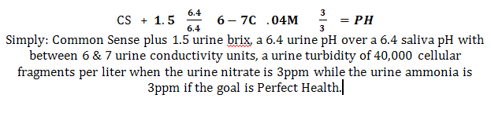
Rule 8: RBTI expresses biological life in mathematical terms…
Every degree of biological life can be expressed in mathematical terms.
The teachings of
Dr. Carey A. Reams

Slide 22

Rule 9: We live off the energy of the foods we eat…
We live from energy. We do not live from the foods we eat. We live off the energy of the foods we eat.
Come Again?
The teachings of
Dr. Carey A. Reams

Slide 23

Rule 10: RBTI does not start with food, RBTI starts with energy…
This course on the Theory of Ionization does not start with food. It does not start with the digestive tract. It does not start with anatomy. It does not start with disease. It starts with energy. Energy itself…
The teachings of
Dr. Carey A. Reams

Slide 24

Rule11: Biological laws of physics are constant; application varies…
The biological laws of physics are constant. It's only application of those laws that makes them different.
The teachings of
Dr. Carey A. Reams
SOME CLARITY MIGHT HELP

Slide 25

Rule 12: In the RBTI some words/terms are redefined…
I will be using some terms throughout this class that will redefine and rephrase. Books will be used for clarification of definitions and some of the questions to show that they can be applied anywhere, anytime, anyplace under any circumstances because the biological laws of physics are constant. We are going to have definitions in just a little while to teach you what the meanings of the words are as we use them in this class because I may use a word and you may have some other different idea of what that word means. And you will go away completely confused and if there is anybody tonight that is not confused, you do not understand the situation.
The teachings of
Dr. Carey A. Reams

Slide 26
Rule 13: The RBTI is not perfect and has its weak points…
The teachings of
Dr. Carey A. Reams
This course has its weak points. These weak points will be pointed out to you as we go through. It's not perfect. There's
nothing perfect but God.

Slide 27

Rule 14: The toughest thing is to follow instructions exactly…
There is a verse in the Bible that says, Be ye perfect. Now this is going to be the toughest thing in this class, is to be perfect, to follow exactly the instructions.
I said SIX drops, not four!
The teachings of
Dr. Carey A. Reams

Slide 28
Rule 15: Math is a very precise art, science, and language…
You must learn exactly to carry out the instruction.
Carry out exactly as it says because mathematics
is a very precise art and science. It's an art and
science and it is also a language.
The teachings of
Dr. Carey A. Reams

Slide 29
Rule 16: Chemistry + math = physics with a reason, cause, and result...
The teachings of
Dr. Carey A. Reams
When you combine chemistry with mathematics you have physics. And physics has a reason. And if there's a reason, there is a cause. And if there is a cause, there is a result. So this is what it's about.

Slide 30
Rule 17: Get your eyes off the numbers; see the picture…
Now one of the most difficult things you are going to find as you step into class is this: get your eyes off the numbers.
Numbers do not tell you anything now and they never will, but they do talk. And they do paint pictures.
If you don't believe numbers talk, even scream, just look at your bank statement on the first of the month. Those numbers on the page tell you what is happening. Do you see what I am getting at?
Those numbers also paint a picture.
The teachings of
Dr. Carey A. Reams

Slide 31
Rule 18: Three kinds of energy; two sources, anionic & cationic…
We are going to be dealing in this class with energy.
There are three kinds of energy. There is matter, which is a form of energy. There is heat and there is electricity.
If you should look at a box full of energy, in the broadest sense of the term, it would look something like the parts of a jigsaw puzzle.
When you feel the heat coming off a stove, whether it's an electric stove, or a coal heater or a wood heater, those little particles of heat are actual molecules of matter. We don't think of them as matter, but they are. They are actually substance, rather than matter.
These little particles are coming off and we are going to learn that there are two sources of energy. We are going to learn there is an anionic source of energy and there is a cationic source of energy.
The teachings of
Dr. Carey A. Reams

Slide 32

Rule 19: Smallest thing is an anion…
The smallest thing that God ever made was an anion. There is nothing smaller than an anion.
It's the smallest thing God ever made and if you leave a single anion, you are in nothingness. Absolute nothingness---there is nothing any
smaller than that.
Yeah, well what about a half an anion?
The teachings of
Dr. Carey A. Reams

Slide 33
Rule 20: Anions have 1-499 units of energy…
We call these small units Milhouse units of energy, abbreviated “mhu”.
We speak of an anion as having up to 499 Milhouse units of energy and still think of it as being one anion.
Actually, it's very difficult in our English language to differentiate between 1 and 499 or any number between them. So it is counted as one anion.
It's something like this. If you had a pitcher with marbles in it, each marble would represent an ion. You wouldn't have one solid marble in there. You would have marbles. So we just say one anion, meaning a combination of a differentiated power of energy.
The smallest anion contains one mhu of energy. And the largest anion contains 499 mhu of energy.
The teachings of
Dr. Carey A. Reams

Slide 34
Rule 21: Cation has 500-999 mhu…
The next smallest thing that God ever created was a cation.
The smallest cation contains 500 Milhouse units of energy and you cannot take it apart.
The largest cation contains 999 Milhouse units of energy.
Perhaps again you can visualize marbles, but there is a vast difference between an anion and a cation.
The teachings of
Dr. Carey A. Reams

Slide 35

Rule 22: In an anion, the electron travels clockwise; in a cation, it travels counter-clockwise…
The teachings of
Dr. Carey A. Reams
In an anion, the electron (if you could split the atom open and watch the electron rotating, the electron is the outer shell) is rotating clockwise (facing the clock) around the nuclei.
In a cation, the electron, under the same conditions, travels counter-clockwise.
Actually, you find the same principle in electricity. The difference in a negative charge and a positive charge is the direction in which it travels. So therefore you find a similarity.
When you speak about electricity you are dealing in voltage, wattage, and ohmage, but here you are dealing in Milhouse units and they are much smaller.
You’re messing with my head, right?

Slide 36


Rule 23: Frequency of male, .0000024; female, .0000026…
The teachings of
Dr. Carey A. Reams
Frequency is the amount of time it takes for one electron to travel around one molecule.
.0000024 is the frequency of all human males on earth. Every male on earth has that frequency regardless of color, race, creed, nationality, or anything else.
The female frequency is .0000026. That is the frequency of all human females. Aren't you glad there is a difference?
Wherever there is male and female, the female is always two higher than the male.
Man, this guy is
giving me brain
fatigue
Yeah, but in the real
world Reams’ theory
seems to fit better
than any other

Slide 37
Rule 24: In God's image: on the same frequency…
In God's image means on the same frequency.
In the first chapter of Genesis where it says, And God created man in His own image, this is what it means: on the same frequency.
The teachings of
Dr. Carey A. Reams

Slide 38
Rule 25: Once you know the frequency you can know the diet…
Now, here is a rule. And you are not going to forget this rule.
Once you know the frequency, then you can know the diet. Without the frequency you will not know the diet. This is absolutely
inseparable. Unless you know the frequency then you cannot make a person's diet. There are some variables."
The teachings of
Dr. Carey A. Reams

Slide 39
Rule 26: Micronage is the pattern that the anions/cations form..
Without giving them any plans, let a million builders loose to build 3-bedroom brick houses. Same bricks, but no two houses will look alike.
Micronage, the forerunner of frequency, is the pattern that the anions and cations (think “bricks”) are stacked together to form elementary or compound molecules. There is more: milli-micronage and milli-milli-micronage.
If you know the frequency, you can plan a diet, but there are variables because one diet doesn’t fit everybody.
We are different and we can look to micronage to understand those differences.
The teachings of
Dr. Carey A. Reams

Slide 40
Rule 27: Micronage makes the difference in the species.
The micronage in the plant and animal kingdom makes a difference in the species. All in the same kind, or kingdom.
For instance, you have in the dog kingdom, the canine kingdom, wolves, foxes, hound dogs, blood hounds, pointer dogs, and you name it. They are all dogs, but of different species.
In the cattle kingdom you have the deer, buffalo, elk, moose, Angus, Jerseys, Holstein, and all of them are different species. The species are the different varieties
The teachings of
Dr. Carey A. Reams

Slide 41
Rule 28: Impossible to cross the frequencies (kinds of creatures)…
You cannot cross the frequencies. It is impossible!
You can divide the frequencies into species. The species are different because there are many ways you can stack the atoms together in order to make the same frequency. We call this micronage. Micronage is the molecular pattern that makes the frequency.
Under micronage you have milli-micronage which is the path of the electronic orbit that light strikes and gives us color, shades, and tints.
Under that, we have milli-milli-micronage which is identity, which makes everything different, one from another.
It is absolutely impossible to cross the kinds because of the micronage, milli-micronage and milli-milli-micronage as well as the frequency. Therefore, man was created by God.
The teachings of
Dr. Carey A. Reams

Slide 42
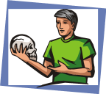
Rule 29: mol is a molecule…
The teachings of
Dr. Carey A. Reams
A perplexed student asked “Doc” for clarification of frequency. He responded that it is the time it takes for one electron to travel around a mol, or molecule, of anything. Interestingly, in a human being, it doesn't matter what molecule, it is all the same.
I think, therefore I am.
I think…

Slide 43

Rule 30: Electrolyle--Any substance that conducts electricity…
An electrolyte is any substance that conducts electricity.
The teachings of
Dr. Carey A. Reams
Did you feel anything when you touched the wire?
I guess the power was off
No
Grrr!

Slide 44
Rule 31: Catalyst--substance that joins two or more substances…
A catalyst is a substance that joins two or more elementary or compound substances together without becoming a part of the union.
For instance, water is one of the finest catalysts known.
Also, we can think of a catalyst as a wrench joining a bolt and nut together. The wrench does not become a part of the union.
Or a preacher that marries a man and a woman does not become a part of the union.
The teachings of
Dr. Carey A. Reams

Slide 45
Rule 32: The term element...
An element is a substance with all molecules having the same number of electrons in orbit or probably the same number of electrons in orbit. But just because it has the same number of electrons in orbit does not mean that they are all alike because of the variables in the anionic and cationic power.
The teachings of
Dr. Carey A. Reams

Slide 46
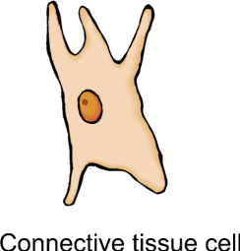
Rule 33: Carcinoma, a cell between a perfect cell and dead cell…
The teachings of
Dr. Carey A. Reams
It is something like a new tire. They may put a brand new tire on your car, but after you drive it five miles, it is an old tire. And this carcinoma cell may be one that is just beginning to lose energy.
(perfect)
(carcinoma)
(dead)
time
time

Slide 47
Rule 34: A cancer cell is a dead cell…
That old “carcinoma” tire will be an old tire until it is worn out, and then it will represent a cancer cell when there is not another mile on it. You do what you will, but there are no more miles on it.
That would be a cancer cell, so to speak.
The teachings of
Dr. Carey A. Reams

Slide 48
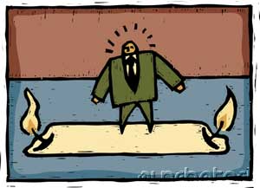
Rule 35: Illness begins when you lose more energy than you gain…
Illness begins the day that you burn up or consume more energy than you take in.
The teachings of
Dr. Carey A. Reams

Slide 49
Rule 36: Two stores of energy; energy you use & reserve energy...
There are two stores of energy. There is the energy you use in daily life and there is your reserve energy.
I think I’ll keep a tidy reserve in a savings account .
I just write a check for anything I want, any day I want it.
The teachings of
Dr. Carey A. Reams

Slide 50
Rule 37: Every cell should be exchanged every 6 months…
I'm speaking about adults now. Children exchange cells faster than that. For instance, a baby chick changes every cell in its body every two days. I mean, bone, everything. Everything in just two days. The chick doesn't have cancer. It's in perfect health. It's growing up normal.
You've heard it said that every cell in our bodies is changed every seven years. That proverb was made over 100 years ago.
If you take longer to replace the cells than 6 months for adults, it shortens the span of life.
The teachings of
Dr. Carey A. Reams

Slide 51
Rule 38: Only one cause of cancer, a mineral deficiency…
There is only one cause of cancer and no more. Just one. And that is a mineral deficiency. Just a mineral deficiency. And cancer begins because there are not enough minerals to replace the cells that should be exchanged, and therefore they wear out.
The teachings of
Dr. Carey A. Reams
Give us a few more trillion and
we’ll win this War On Cancer
Hey, didn’t they say
that a few trillion back?
They did!

Slide 52
Rule 39: Carcinoma cells are passed out through kidneys…
The pressure that is put upon a dead cell by the healthy cells around it presses it into the blood stream so that it goes into the blood stream, is then filtered out by the kidneys into the urinary tract, and finally goes out.
This is the way carcinoma cells are passed out of our body. They do not go into the colon. They go out through the urine. And God made us that way so that we could be friends and be around each other and not have BO. If these dead cells came out through the skin, you could smell it for a mile or more. You couldn't use enough soap. God lets it go out through the urine, and the solution is rather dilute.
The teachings of
Dr. Carey A. Reams

Slide 53
Rule 40: Perfect health, urine should be clear like water…
Whenever you are drinking the correct amount of water and you are in perfect health, the urine should be as clear as the water you drink, absolutely clear.
People, who are absolutely perfect and drink the right amount of water for their weight, should have at least 40,000 dead cells in a liter of urine every day of their life. This is when they are drinking the normal amount. Children are lower than that.
If you have eaten something with coloring in it, then it will change the color of the urine a little bit, but only temporarily.
The teachings of
Dr. Carey A. Reams

Slide 54

Rule 41:Women in perfect health, menstrual flow transparent…
Women who are in absolutely perfect health, the menstrual flow is transparent. It is crystal clear. There is no redness in it at all. It's absolutely transparent. It is clear. There should be no blood cells in it when you are in perfect health.
Is that a promise?
The teachings of
Dr. Carey A. Reams

Slide 55


Rule 42: Once you know what perfect is....
The teachings of
Dr. Carey A. Reams
This is what I am teaching you, once you know what perfect is, then you can find out what imperfect is and then how to work toward perfect.
There is a difference

Slide 56
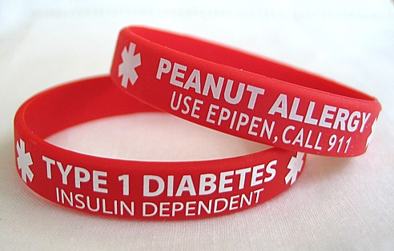
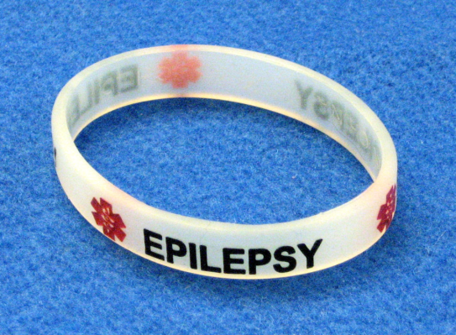
Rule 43: Epileptic & diabetic seizures appear the same…
You cannot tell the difference between an epileptic seizure and a diabetic seizure by looking. They look exactly alike. There's no way to tell without these tests.
However, we are going to learn quite a lot more about diabetes before this course is over. About how to handle it and what to do and how to determine whether a seizure is diabetic or epileptic.
The teachings of
Dr. Carey A. Reams

Slide 57
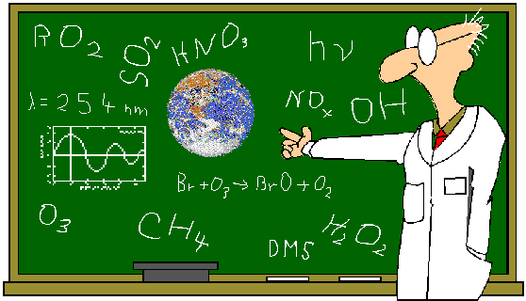
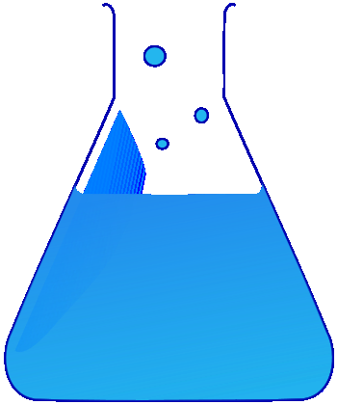
Rule 44: Three branches of chemistry: organic, inorganic, colloidal…
There is organic chemistry; there is inorganic chemistry; and there is also colloidal chemistry.
The teachings of
Dr. Carey A. Reams
Carbon
No carbon
Colloids

Slide 58
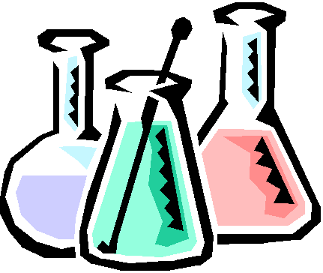
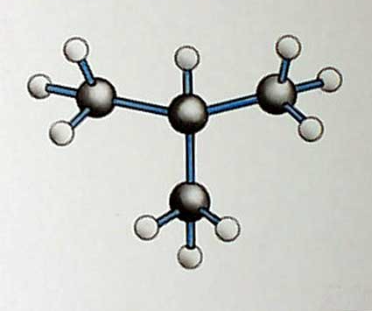
Rule 45: Organic chemistry deals with carbons…
The teachings of
Dr. Carey A. Reams
Organic chemistry is the branch of chemistry that deals with the carbons, any substance containing carbon.

Slide 59

Rule 46: Inorganic chemistry…
Inorganic chemistry simply refers to the chemistry of those materials that do not contain carbon.
The teachings of
Dr. Carey A. Reams

Slide 60
Rule 47: Colloidal chemistry has two different branches…
One branch of colloidal chemistry deals with the measurement of size. For instance, you can have colloidal gold, colloidal iron, colloidal manganese, which is only a measurement of size.
There is also chemical colloid, a compound colloid, which conforms to the size but it is different.
The teachings of
Dr. Carey A. Reams

Slide 61
Rule 49: A true chemical colloid is a complete solar system unto itself…
It cannot be taken apart. It cannot be divided. There are just so many of them and no more.
Without colloids we would not have bones, teeth, or fingernails.
In fact, there would be no life upon the earth without the colloid.
The colloidal structure of a vine destines it to climb something---a rope, a post, a wire, a tree…
The colloidal structure of a tree destines it to stand strong and upright.
The colloidal substance in the wood itself, or in the vine itself, makes the difference.

Slide 62
Rule 50--Colloids are so fine that gravity has no attraction...
Colloids are repelled by both the negative and positive poles.
They are so fine that they will pass right through Pyrex glass with no problem at all.
They are wonderful little things to know about, and without them there would be no life on the earth.
They are the diamond in the dew drop.
This is what your fingers are made of, your fingernails, your palms.

Slide 63
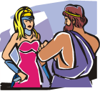
Rule 56: The laws of nature are constant, never confused…
For instance, a team of scientists and doctors explaining the virtues of drug “x” will not make near the impression on you than will actually watching your own fingernails grow super-strong merely from taking a mineral-colloid supplement.
Yeah, well I’d like to see the FDA approval on that one
You won’t, silly boy. Some things you have to see for yourself

Slide 64
The RBTI has much to say about the puzzles of life…
Cholesterol
Varicose veins
Heart attacks
Kidney stones
Arthritis
Cancer
Crib death
Strong bodies, clear minds
And many other
problems…
SHORT DISCLAIMER
Please remember that State laws require that you consult with a licensed medical professional for advice and/or treatment of any disorder.

Slide 65
More information
We hope you have enjoyed your introduction to the fascinating Reams Biological Theory of Ionization.
If you wish to know more, you may find the following contacts of use…

Slide 66
Websites of note…
http://health.groups.yahoo.com/group/RBTI/
(General RBTI discussion)
http://brixman.com/
(General RBTI info)
http://advancedideals.org/index.html
(Textbooks and RBTI instruction)
http://www.heavenlywater.com/catalog/
(Textbooks and RBTI instruction)
http://www.olszta.com/rbtiinstruction2008
(Online & FAXable RBTI courses)
http://www.pikeagri.com
(RBTI instrumentation and books)
http://www.daily-mfg.com
(RBTI supplements)
http://christianhealtheducation.com
(RBTI home study)

Slide 67
Full length disclaimer…
The claims made in this PowerPoint presentation have not been evaluated by the United States Food and Drug Administration and are not intended to diagnose, treat, cure or prevent disease. The information provided in this presentation is for informational purposes only and is not intended as a substitute for advice from your physician or other health care professional. You should not use the information in this presentation for diagnosis or treatment of any health problem or for prescription of any medication or other treatment. You should consult with a healthcare professional before starting any diet, exercise or supplementation program, before taking any medication, or if you have or suspect you might have a health problem
Every intelligent medical doctor admits that drugs do not cure or heal any disease.
Carey A. Reams, Choose Life Or Death

